Slide 1
Translation with Neural Networks
Iago Alés
Jordi Esteve
Arnau Ayguadé

Slide 2
Introduction
Objective
First approach
Second approach
Third approach

Slide 3
Objective
Our aim from the start was to create a translation model with our resources

Slide 4
Transformers

Slide 5
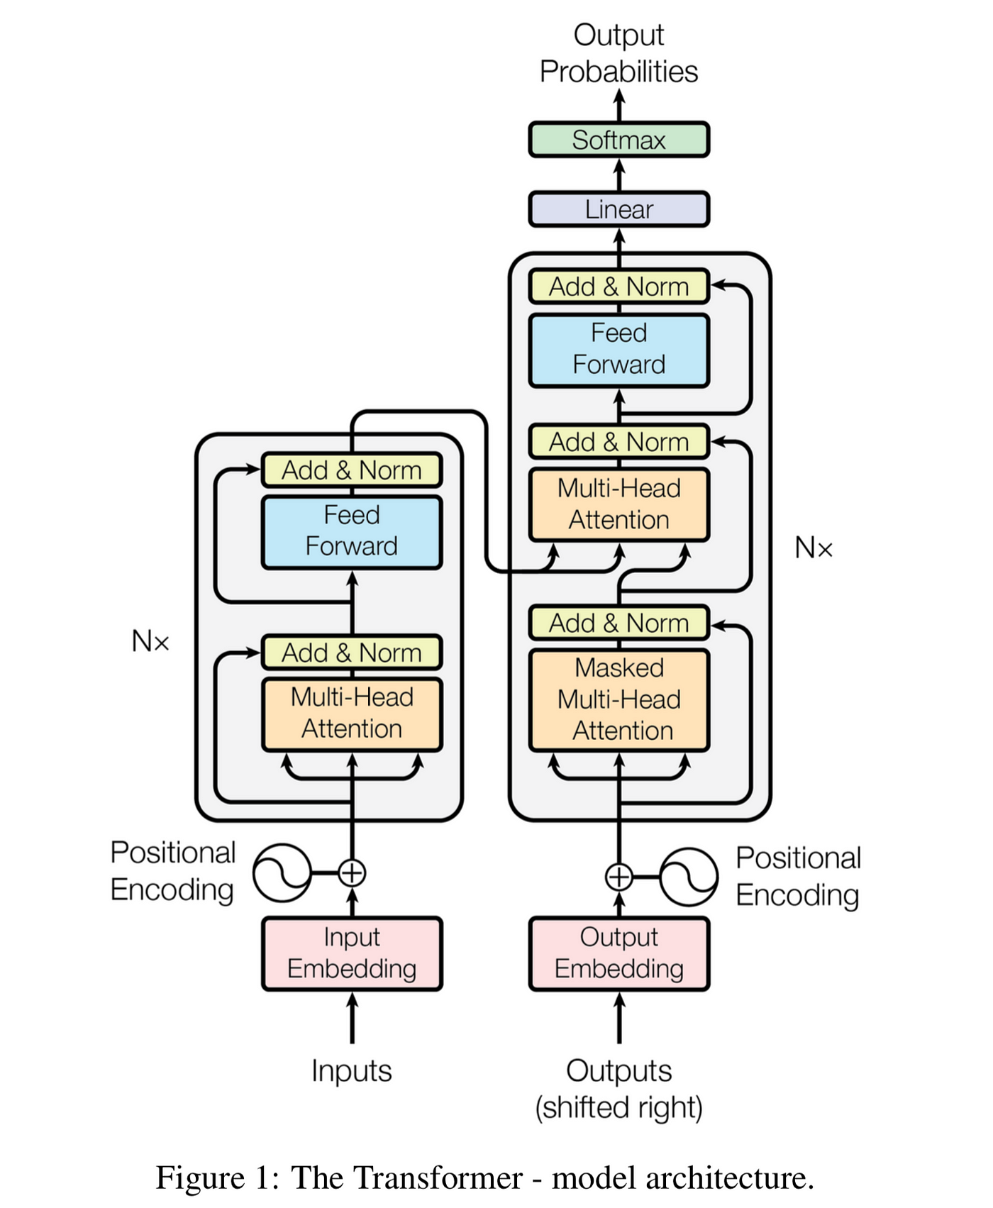
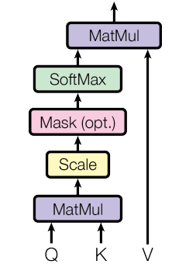
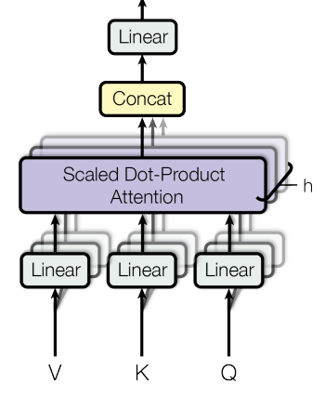
Transformers

Slide 6
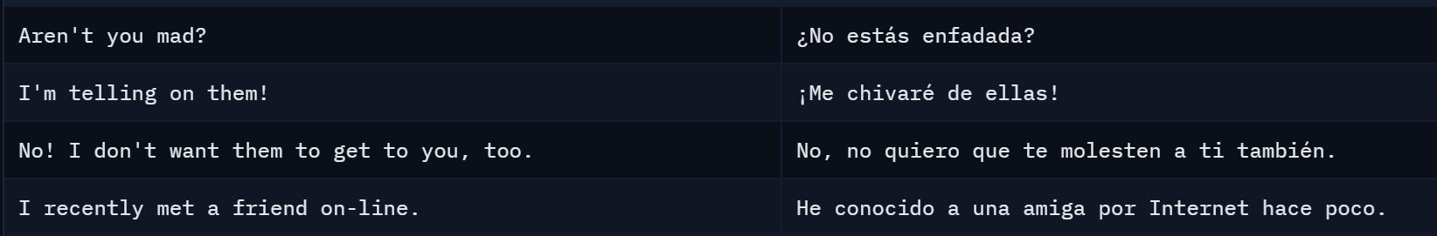
Transformers: Dataset
sentence-transformers/parallel-sentences-opensubtitles
English-Spanish
13M examples

Slide 7
Transformers: Fine Tune
T5 small model.
Good for Translation, Summarization and Fill-in-the-blank
60 M parameters

Slide 8
Transformers: T5 model architecture
Embedding
6 Encoder Stacks:
Self-Attention (Query, Key, Value)
Feed-Forward (DenseReluDense)
6 Decoder Stacks:
Masked Self-Attention
Encoder-Decoder Attention
Feed Forward
Output Projection and Softmax

Slide 9
Transformers: Approaches
Small dataset (5000 train) and 2 epoch: small BLEU (few time to train)
Small dataset and 10 epoch: a bit better BLEU but still bad results (few time to train)
Larger dataset (80000 train) 3 epoch: small BLEU (3 hours to train)
Tried changing datasets, to see if it was corrupted, but results didn’t change
Same dataset 5 epoch: small BLEU but now we saw that the model translated some words correctly (5 hours)
Freezed the encoder, same dataset, 5 epoch: small BLEU but the model translated some phrases correctly, but struggled with long ones (2 hours)
Freezed encoder, diminishing learning rate, 4 epoch (1M train): model progressing correctly but google colab didn’t allow us to train for that long

Slide 10
Transformers: Conclusion
Chinchilla Scaling Law: D_{opt}​≈20×N
If we have 60M parameters, D_{opt}​=1.200M
Unfeasible

Slide 11
RNN (LSTM)

Slide 12
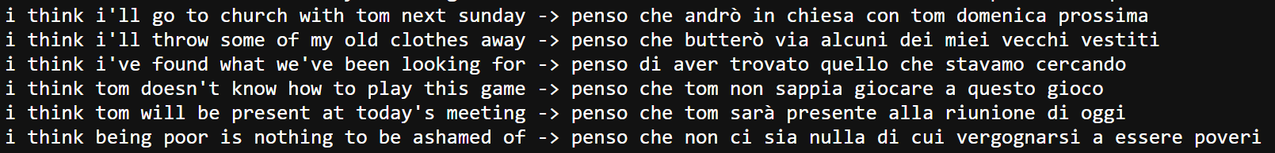
RNN: Dataset
Tried training it with an english to spanish dataset but it took way too long.
We tried the size of the english vocabulary to 5000 of the dataset by choosing only the sentences that contained the 5000 most used words in the english vocabulary in the dataset of 13M, but got too few sentences.
Decided to simulate as if it had less vocabulary, couldn’t find a eng-esp dataset with a small vocabulary but we found a eng-ita, 5000 words vocabulary english.

Slide 13
RNN : Create vocabulary
Previous work: Install dataset and its vocabulary
Create pairs of words
Read data
Extract pairs
Check if they are valid

Slide 14
RNN : Create vocabulary
Mapping words
Tokenize them
Assign integer to every word in vocabulary
Take into account special characters (PAD,EOS,SOS,UNK)
Padding (Process different size samples)
Transforms the samples into the same length samples
Add PAD tokens

Slide 15
RNN : Encoder
Part of the neural network that reads a sentence and transforms it into numbers
Encoder steps:
Reverse all the sentences
Helps model learn long-term dependencies in sequence tasks
Turn words into dense vectors
Using an embedding layer
Processes sequence, learning temporal dependencies
Using a Long Short-Term Memory (LSTM)

Slide 16
RNN : Decoder
Part of sequence-to-Sequence model takes input from encoder and outputs one word at a time
Decoder Steps:
Take input from encoder
Words into vectors
Vectors, Hidden states and Cell states to LSTM
Use linear layer to transform LSTM’s output into a prediction for the next word
Returns:
The output scores (used to pick the next word).
The updated hidden and cell states (to keep track of what’s been generated so far).

Slide 17
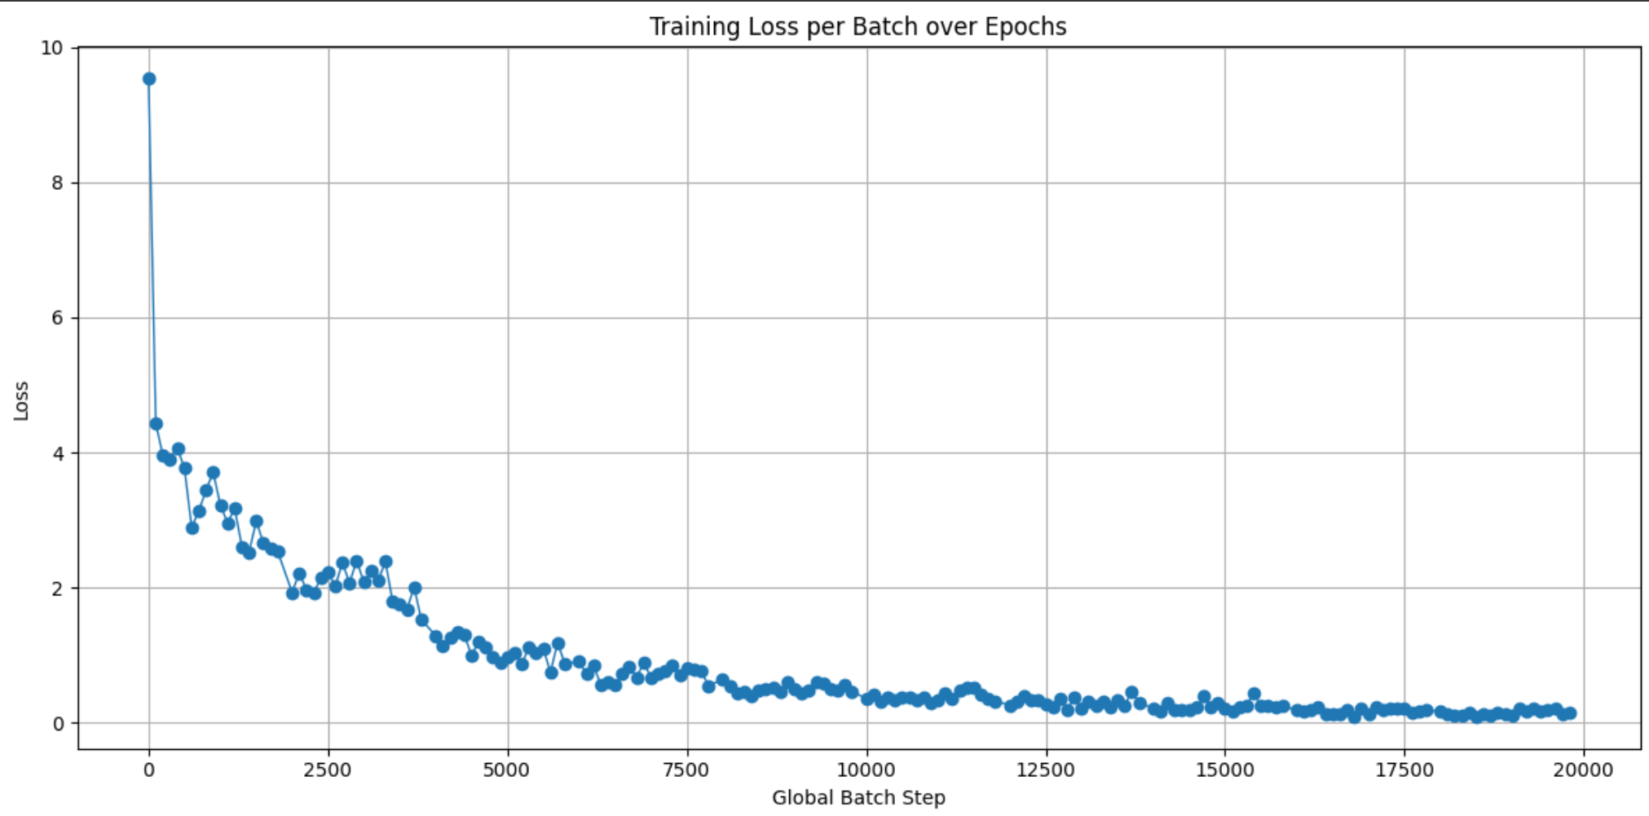
RNN: Training
Loss function: Cross entropy Loss
Optimizer: Adam
Teacher Forcing: feed the actual target token as the next input to the decoder

Slide 18
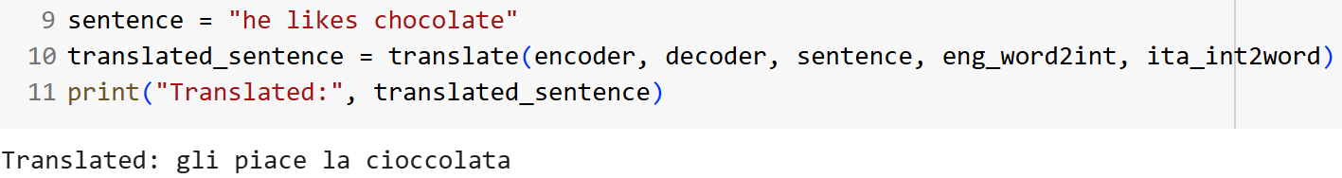
RNN: Results

Slide 19
RNN + Attention

Slide 20

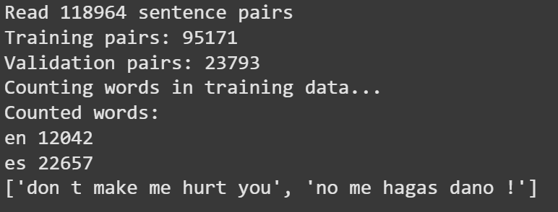
RNN + ATTENTION: Dataset
English –> Spanish
lonnieqin

Slide 21
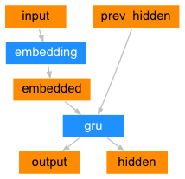
RNN + ATTENTION : Model Architecture
Encoder:
Embedding layer
GRU
Dropout: 0.1
Notes:
Attention Mechanism: Instead of encoding the whole input sequence into a fixed-length vector (bottleneck), attention allows the model to dynamically focus on different parts of the input at each output step.

Slide 22
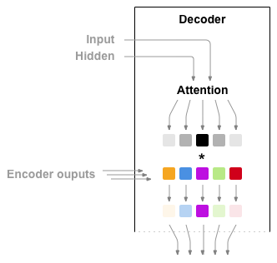
RNN + ATTENTION : Model Architecture
Decoder:
Embedding layer w teacher forcing
Attention: Additive Attention
GRU
Output layer
Notes:
Attention Mechanism: Instead of encoding the whole input sequence into a fixed-length vector (bottleneck), attention allows the model to dynamically focus on different parts of the input at each output step. Given the decoder’s hidden state (query) and all encoder hidden states (keys).
Computes attention scores and weights over encoder outputs.
Produces a context vector: weighted sum of encoder outputs. How much attention the decoder at time step t should pay to encoder hidden state at time step s.
softmax

Slide 23
RNN + ATTENTION: Training
NLLLoss
Adam optimizer
80% train 20% validate
20 epochs
Learning rate = 0.001
Embedding size = 256
Hidden size = 256
Batch size = 64
DATASET | PARAMETERS | TRAINING TIME | FINAL LOSS
First 10k samples | 3,718,839 | 10 min | 0.1473
55k with short sentences and common words | 4,068,999 | 1h | 0.2091
60k random sentences | 5,528,046 | 6h | 0.1633

Slide 24
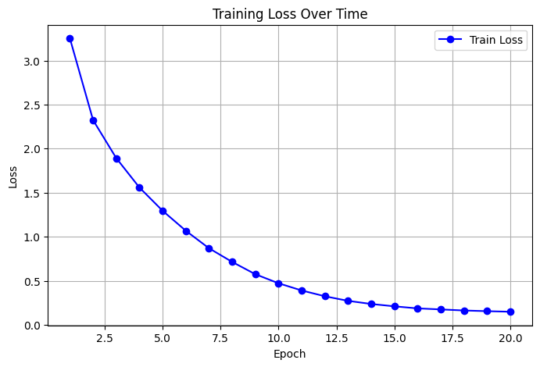
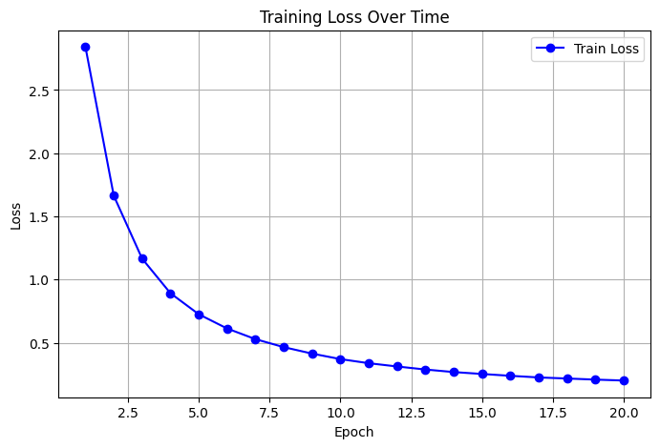
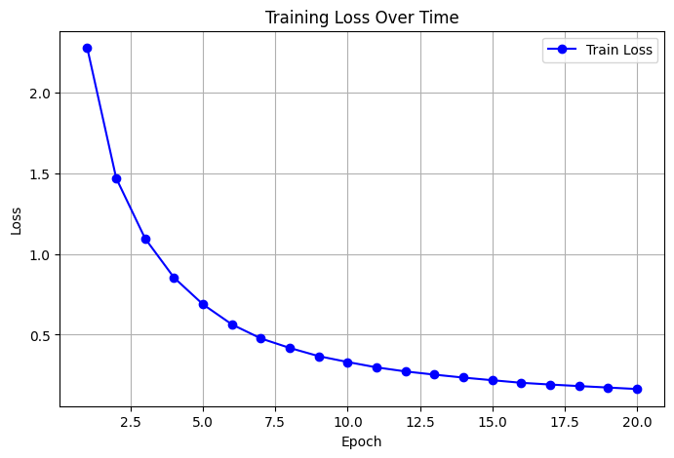
RNN + ATTENTION: Training
Evolution on training loss over 20 epochs with 10k pairs of sentences
Evolution on training loss over 20 epochs with 55k pairs of sentences
Evolution on training loss over 20 epochs with 60k pairs of sentences

Slide 25
RNN + ATTENTION: Results
EVALUATION METRICS USED:
Name
What measures
Range
Sensitivity
METEOR score
unigram precision + recall + synonym matches + order
0 to 1
uses stemming, synonyms, word order, recall
BLEU score
1 to 4-gram precision
0 to 1
missing words, sentence length
Notes:
Short sentences have:
Fewer n-grams.
Less chance to get good n-gram matches.
BLEU is harsher on short sentences.
not recall (it doesn’t care if the model misses words).
A small mistake → huge penalty. Stemming: Reducing a word to its base form by chopping suffixes (cheap but rough).Helps match similar words

Slide 26
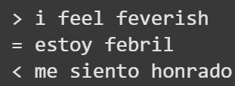
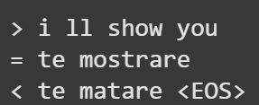
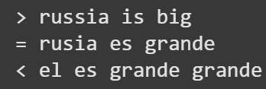
RNN + ATTENTION: Results
10k dataset Results
BLEU: 0.0915
METEOR: 0.3655
Notes:
Short sentences have:
Fewer n-grams.
Less chance to get good n-gram matches.
BLEU is harsher on short sentences.
A small mistake → huge penalty.

Slide 27
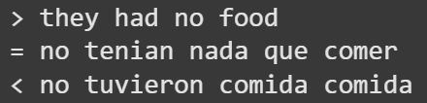
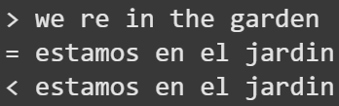
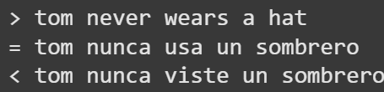
RNN + ATTENTION: Results
55k dataset Results
BLEU score: 0.2002
Average METEOR: 0.5056
Notes:
Short sentences have:
Fewer n-grams.
Less chance to get good n-gram matches.
BLEU is harsher on short sentences.
A small mistake → huge penalty.

Slide 28
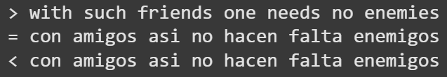
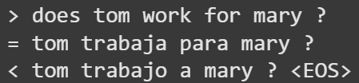
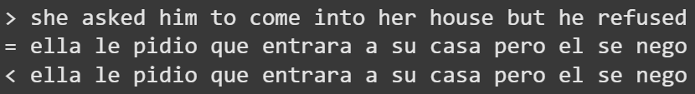
RNN + ATTENTION: Results
60k dataset Results
BLEU score: 0.3698
Average METEOR: 0.6078
Notes:
Short sentences have:
Fewer n-grams.
Less chance to get good n-gram matches.
BLEU is harsher on short sentences.
A small mistake → huge penalty.

Slide 29
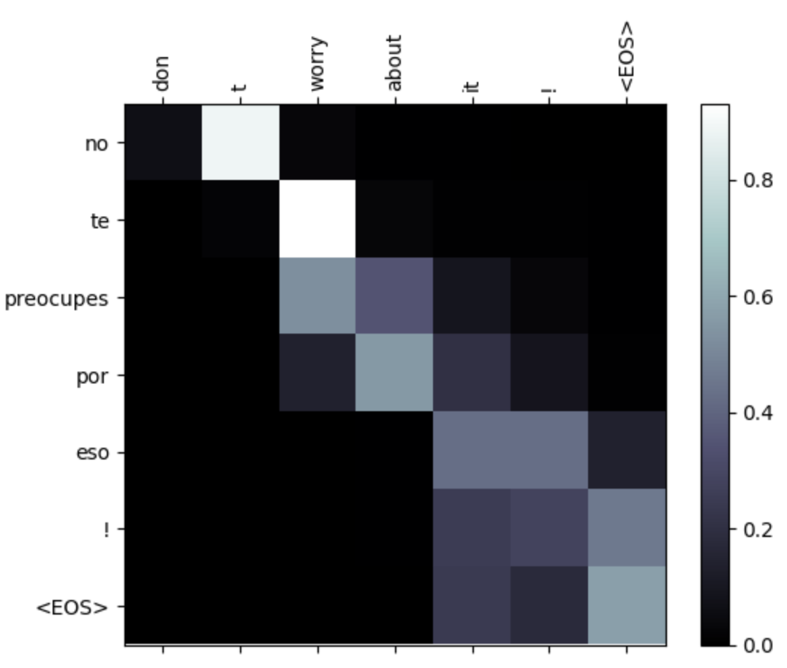
RNN + ATTENTION: Results
Attention Matrix:
Rows = target tokens (Spanish output tokens).
Columns = source tokens (English input tokens).
Each cell = attention weight for that output word at
that input word.
Dark = low attention
Light = high attention.
Notes:
Short sentences have:
Fewer n-grams.
Less chance to get good n-gram matches.
BLEU is harsher on short sentences.
A small mistake → huge penalty.

Slide 30
Further Investigation
Try to make transformers work, maybe create a simpler model and train it from scratch
Try to train the LSTM with an english to spanish dataset, either with small vocabulary or not
Add pre-loaded weights for the embedding

Slide 31
Thanks for your ATTENTION

